Slide 1
II: Ames_raw IDs and sweet corn & popcorn processing:
raw GBS set filtering for imputation
Filtering: entries call rate >= 20%; SNPs call rate >= 50% ...
Xiaowei Li & Di Wu
Gore Lab
2019-11-22

Slide 2
Ames_RAW IDs and sweet corn & popcorn processing: raw GBS set for imputation
Ames_hmp3
filtered for GWAS
2015_vb
Raw data; 1802 plots
103 B73; 1699 accessions
2015_ve
Raw data; 1801 plots
103 B73; 1698 accessions
2017_vb
Raw data
1748 plots
Remove 10 measurements from Plate 19th;
Correct “H22w” and “B73” switch error
Correct “H22w” and “B73” switch error
2017_ve
Raw data
1738 plots
SNPs filtering:
(1) bi-allelic,
(2) DR² >= 0.8,
(3) MAF >= 0.01
2017_vb; 1738 plots
44 B73; 1694 accessions
2017_ve; 1738 plots
44 B73; 1694 accessions
Ames_hmp3
d2015
1699 unique
accession IDs
d2017
1694 unique
accession IDs
imputation
Ames_2013gb_Cinta
2815 accessions
135 sweet corn and 79 popcorn
1462 entries 443,419 SNPs
Pheno
Ames_isu
1762 unique accession IDs
133 sweet corn and 99 popcorn
Retain
polymorphic SNPs
1462 entries 448,553 SNPs
Ames_isu_v2.7
1779 GBS entries for 1493 accession IDs
Including 228 IDs with >=2 GBS entries
1 accession to >= 1 GBS entries
ZeaGBSv2.7_RAW
17280 GBS entries
Ames_isu_2013gb
1762 unique accession IDs
120 sweet corn and 75 popcorn
Including 38 discrepancies
using all SNPs for samples filtering:
(1) call rate >= 20%,
(2) Het <= 10%,
(3) F >= 0.8
sweet & pop
1474 entries
448,553 SNPs
1 entry to 1 accession
1265 accessions
single GBS entry
228 accessions
>=2 GBS entries, 514 entries
36 were fixed by NPGS
Including 13 sweet and 23 popcorn
Ames_isu_locked
1497 accession IDs
Consensus call
entries call rate >= 20%
83 unclassified check list from PCA
Including 11 popcorn by NPGS
8 accessions
1714 entries
448,553 SNPs
SNP call rate >= 50%, Het <= 10%, F_{IT} >= 0.8, MAF >= 0.01;
LD pruning --indep-pairwise 100 25 0.2;
calculating IBS for 1754 entries;
subsetting IBS matrix for 220 accessions with >= 2 entries
Removed 12 “ae” lines and 7 lines with abnormal endosperm
SNPs filtering:
(1) bi-allelic
(2) polymorphic
1265 + 8 accessions
single GBS entry
Ames_isu_2013gb_NPGS
1762 unique accession IDs
133 sweet corn and 109 popcorn
4 in-question
IBS_mean >= 0.95; dropped 19 accessions
Ames_isu_common
1516 accession IDs
DE3: “13A089451A" to
"PI 638551"
Removed
4 in-question;
242 sweet & popcorn
1714 entries
943,455 SNPs
201 accessions
441 entries
201 accessions
>=2 GBS entries
Geno

Slide 3
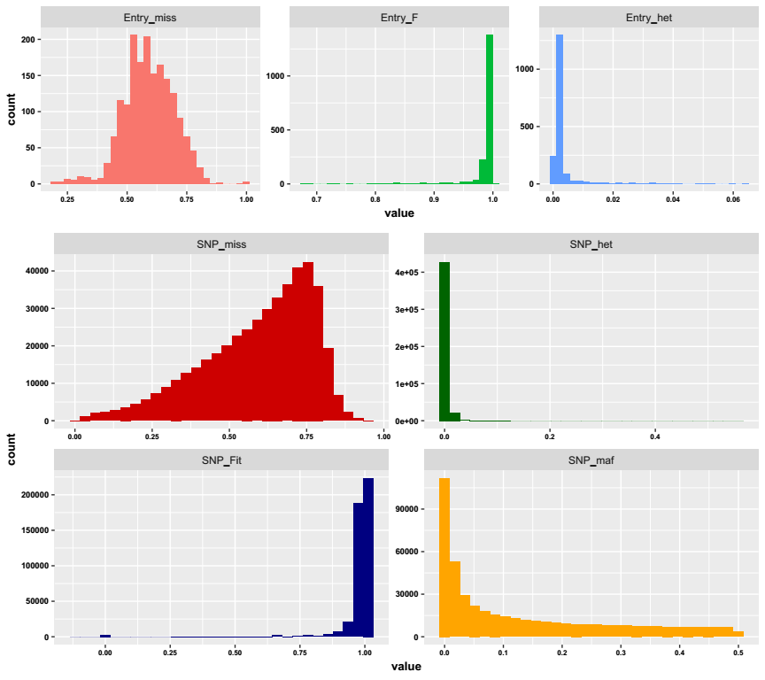
Ames_GBS_RAW: filtering 1779 entries (1493 accessions) and calculating IBS for line selection
Characteristics of 1779 entries and 451,319 SNPs
Raw data
1779 entries * 943,455 SNPs
SNPs bi-allelic
1779 entries * 787,596 SNPs
SNPs with MAF > 0
1779 entries * 451,319 SNPs
entries with a call rate >= 20%
1754 entries * 451,319 SNPs
SNPs with a call rate >= 50%
1754 entries * 128,206 SNPs
SNPs with Het <= 10%
1754 entries * 128,134 SNPs
SNPs with F_{IT} >= 0.8
1754 entries * 124,795 SNPs
SNPs with MAF >= 0.01
1754 entries * 104,146 SNPs
SNPs LD pruning r² = 0.2
1754 entries * 32,267 SNPs
64 IDs with IBS_mean < 0.99
19 IDs with IBS_mean < 0.95
1273 (1265 + 8) single
+ 201 consensus
Ames_raw_1474

Slide 4
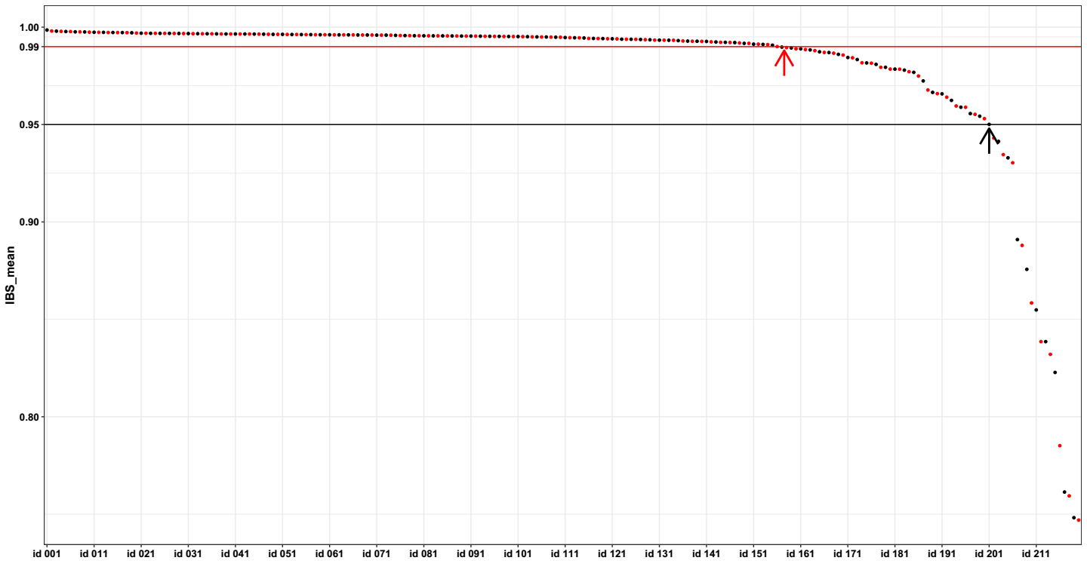
Filtering: retain entries with call rate >= 20%; retain SNPs with call rate >= 50%, Het <= 10%, F_{IT} >= 0.8, MAF >= 0.01; SNPs were pruned with a window of 100 adjacent SNPs and a step size of 25 SNPs (r² threshold was 0.2)
IBS analysis for 1754 GBS entries and subsetting IBS matrix for 220 line IDs with >=2 GBS entries : 64 IDs with IBS_mean < 0.99; 19 IDs with IBS_mean < 0.95

Slide 5
Ames_GBS_RAW: Pre-imputation samples filtering
1273 (1265 + 8) single
+ 201 consensus
Ames_raw_1474
Raw data
1714 entries * 943,455 SNPs
SNPs bi-allelic
1714 entries * 691,970 SNPs
SNPs with MAF > 0
1714 entries * 448,553 SNPs
Consensus call
SNPs bi-allelic
1474 entries * 448,553 SNPs
samples with call rate >= 20%
1464 entries * 448,553 SNPs
samples with Het <= 10%
1464 entries * 448,553 SNPs
samples with F >= 0.8
1462 entries * 448,553 SNPs
SNPs bi-allelic
1462 entries * 443,419 SNPs
Ready for imputation

